Slide 1
Classification and Regression Trees
Magnus van Niekerk
InSciDa Workshop
January 2016

Slide 2
Classification and Regression Trees (CART)
Segment predictor space into predictive regions.

Slide 3
Classification and Regression Trees (CART)
Segment predictor space into predictive regions.

Slide 4
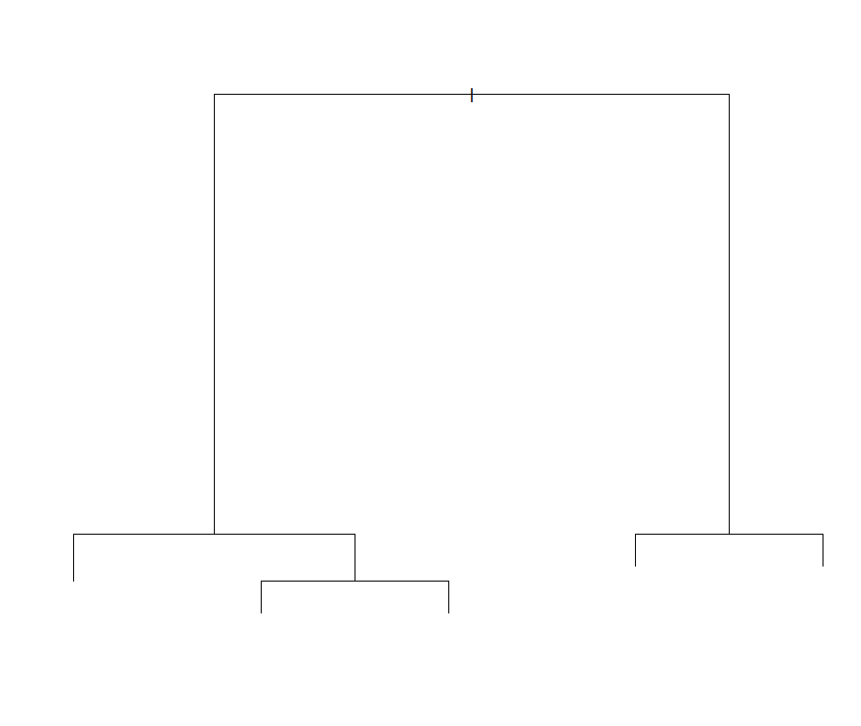
Classification and Regression Trees (CART)

Slide 5

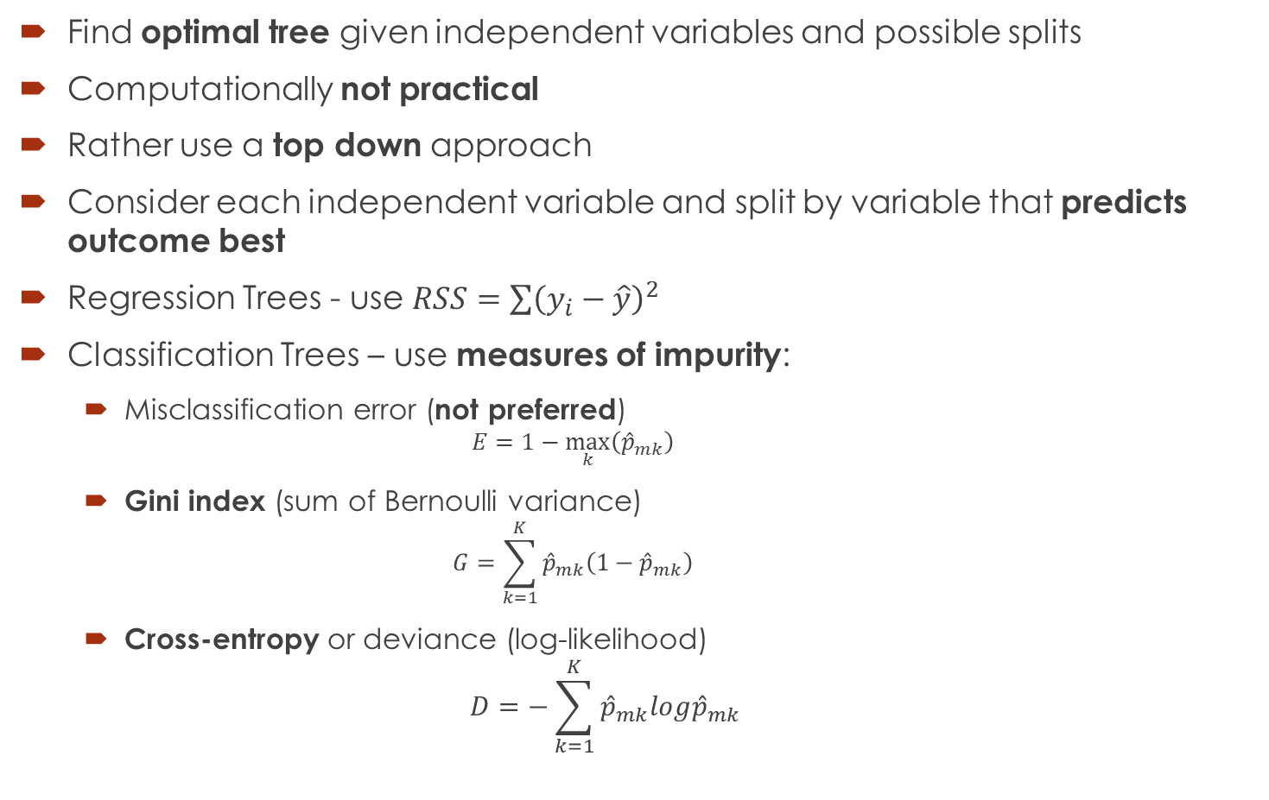
Classification and Regression Trees (CART)
Find optimal tree given independent variables and possible splits
Computationally not practical
Rather use a top down approach
Consider each independent variable and split by variable that predicts outcome best
Regression Trees - use $RSS=\sum{{\left(y_{i}−\hat{y}\right)}^{2}}$
Classification Trees – use measures of impurity:
Misclassification error (not preferred)
$$E=1−\max_{k}\left({\hat{p}}_{mk}\right)$$
Gini index (sum of Bernoulli variance)
$$G=\sum_{k=1}^{K}{{\hat{p}}_{mk}\left(1−{\hat{p}}_{mk}\right)}$$
Cross-entropy or deviance (log-likelihood)
$$D=−\sum_{k=1}^{K}{{\hat{p}}_{mk}log{\hat{p}}_{mk}}$$
$m$ is the current region
$k$ is the class predicted

Slide 6
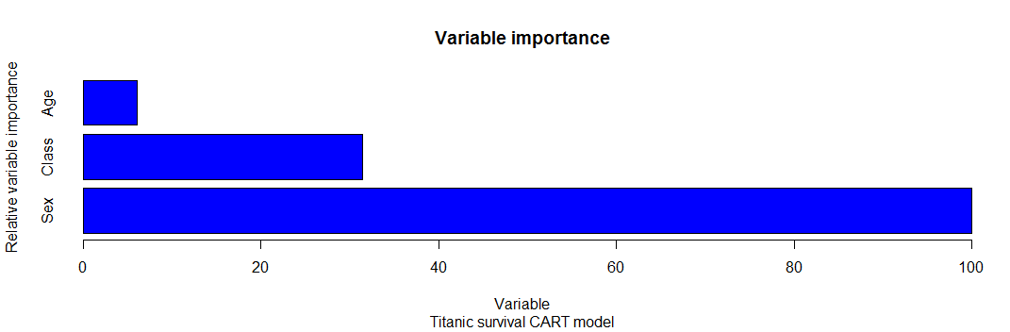
Classification and Regression Trees (CART)
The rpart library in R can be used to build classification and regression trees
library(rpart)
CARTfit <- rpart(Survived ~ Class + Sex + Age, data = df,
control = rpart.control(minsplit = 10, xval = 10))
Standard available output include the variable importance data which shows the increase in the average Gini measure of impurity

Slide 7
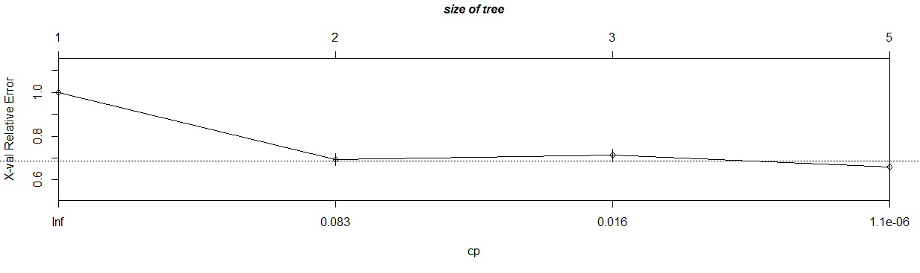
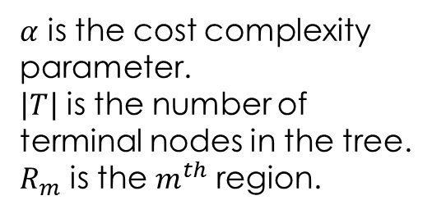

Classification and Regression Trees (CART)
Build a tree using limited only by number of observations in terminal nodes
This will cause a lot of model variance
Use cost complexity parameter to penalise number of terminal nodes used by applying cost complexity pruning using k-fold cross-validation
$$Penalised Error=\sum_{m=1}^{\left|T\right|}{\sum_{{i:x}_{i}∈R_{m}}{{\left(y_{i}−{\hat{y}}_{R_{m}}\right)}^{2}+α\left|T\right|}}$$
It can be shown that for every value of $α$ there is
such a smallest minimizing subtree
$α$ is the cost complexity parameter.
$\left|T\right|$ is the number of terminal nodes in the tree.
$R_{m}$ is the $m^{th}$ region.

Slide 8
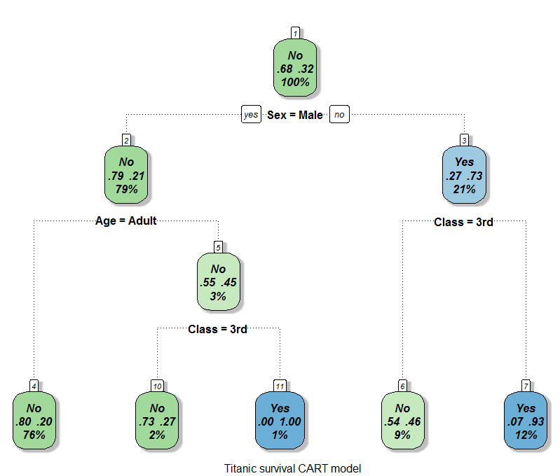
Classification and Regression Trees (CART)

Slide 9
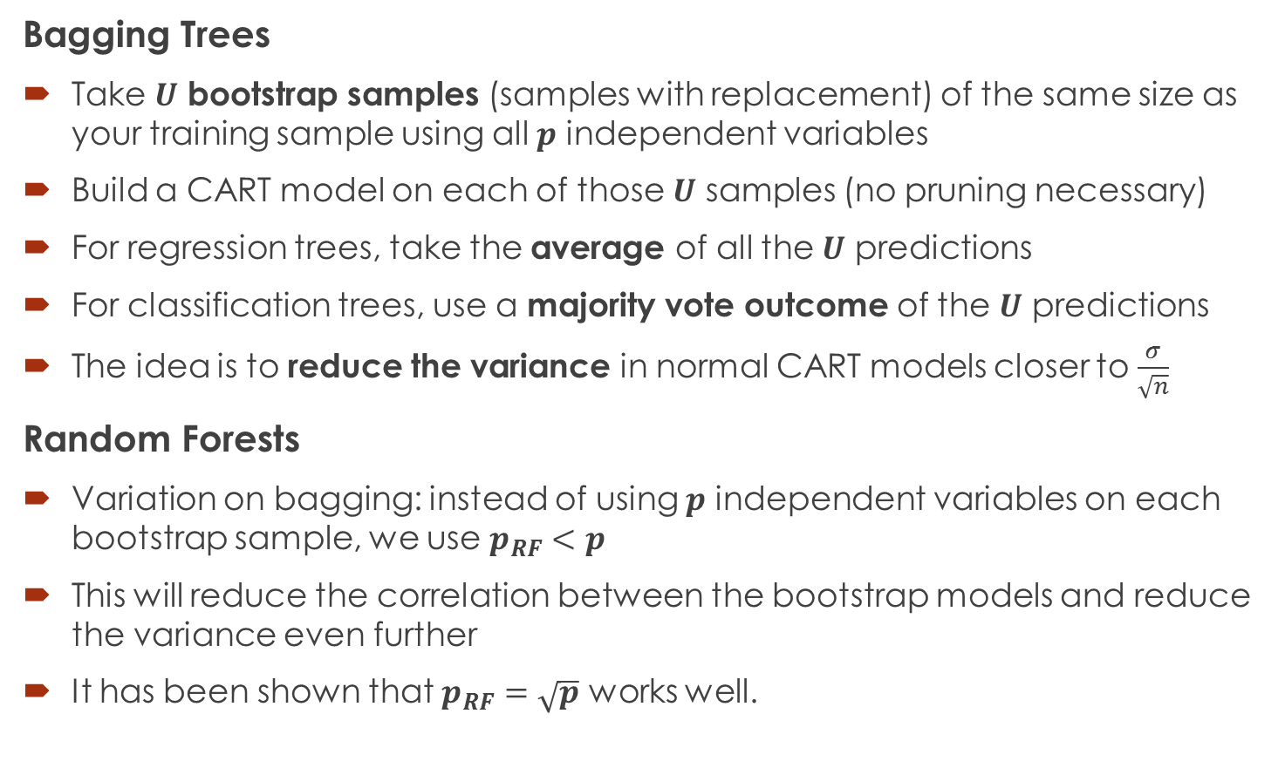
Bagging and Random Forests
Bagging Trees
Take $U$ bootstrap samples (samples with replacement) of the same size as your training sample using all $p$ independent variables
Build a CART model on each of those $U$ samples (no pruning necessary)
For regression trees, take the average of all the $U$ predictions
For classification trees, use a majority vote outcome of the $U$ predictions
The idea is to reduce the variance in normal CART models closer to $\frac{σ}{\sqrt{n}}$
Random Forests
Variation on bagging: instead of using $p$ independent variables on each bootstrap sample, we use $p_{RF}<p$
This will reduce the correlation between the bootstrap models and reduce the variance even further
It has been shown that $p_{RF}=\sqrt{p}$ works well.

Slide 10
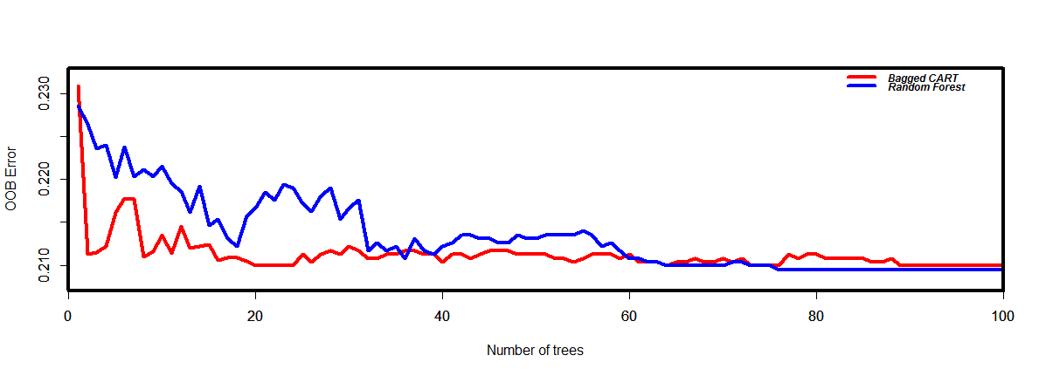
Bagging and Random Forests
The RandomForest package in R is typically used
baggedfit <- randomForest(Survived ~ Class + Sex + Age, data = df,
mtry=3, ntree = 100)
randomffit <- randomForest(Survived ~ Class + Sex + Age, data = df,
mtry=2, ntree = 100)

Slide 11
Classification and Regression Trees (CART)
Advantages of Classification and Regression Trees
Non-parametric segmentation
Results are easy to understand and easy to implement model
Handles missing data well
Can be competitive with right adjustments (Random Forests and Boosting)
Easy to identify variable interactions and importance
Disadvantages of Classification and Regression Trees
Not a very competitive model on its own
Regression prediction is not continuous
Easy to overfit if not pruned properly (see cost complexity pruning)
Model variance is usually very high if not combined with other modelling techniques (see Bagging and Random Forests)

Slide 12
Code and References
https://github.com/Magnusvann/InSciDa2016
Breiman, Leo. "Random forests." Machine learning 45.1 (2001): 5-32.
Friedman, Jerome H. "A recursive partitioning decision rule for nonparametric classification." IEEE Transactions on Computers 4 (1977): 404-408.
rpart: Recursive Partitioning (2011) by Terry M. Therneau, Beth Atkinson, Brian Ripley, https://cran.r-project.org/web/packages/rpart/
randomForest: Classification and Regression by randomForest (2002) by Andy Liaw and Matthew Wiener, https://cran.rproject.org/web/packages/randomForest/

Slide 13


